Slide 1

E-Commerce Funnel Analysis
Soundarraj S
Scaler Student

Slide 2
Agenda
Executive Summary
Dataset Overview
Objectives of the Analysis
Key Analysis Areas
Insights & Findings
Conclusion & Recommendations

Slide 3
Executive Summary
This project analyzes user activity and purchase behavior on an e-commerce platform. It examines the purchase funnel, key product categories, price sensitivity, user engagement, session patterns, and time-based trends.
The analysis also identifies high-value products that contribute most to revenue, helping support clearer product and business decisions.

Slide 4
Dataset Overview
Before Data cleaning
The raw dataset contains 16.8 million records across 9 columns, capturing detailed user interactions such as event time, event type, product and category details, brand, price, user ID, and session ID. This dataset represents the unprocessed data and is taken before handling missing values, duplicates, or any cleaning steps, providing a complete view of all user events on the platform.
After data Cleaning
After data cleaning, the dataset contains 12.49 million records across 15 columns with no missing values. The cleaned data includes enriched fields such as category hierarchy (category, category_1, category_2), event date, day name, hour of day, and time-of-day segments. Event timestamps are standardized to UTC, and event types and time segments are stored as efficient categories. This refined dataset is well-structured for detailed analysis of user behavior, product performance, and purchase trends.

Slide 5
Objectives of the Analysis
Understand user behavior across the platform.
Evaluate the purchase funnel from view → cart → purchase.
Measure category and brand performance.
Analyze price sensitivity of users.
Study session behavior and its link to purchase likelihood.
Identify high-value products contributing major revenue.
Support data-driven product and business decisions.

Slide 6
Key Analysis Areas
Funnel Analysis (View → Cart → Purchase)
Category and Brand Performance
Price Sensitivity (Viewed vs Purchased prices)
User Behavior & Top User Contribution
Session Behavior and Purchase Likelihood
Time-Based Trends (Day & Hour Analysis)
High-Value Products (Pareto Analysis)

Slide 7
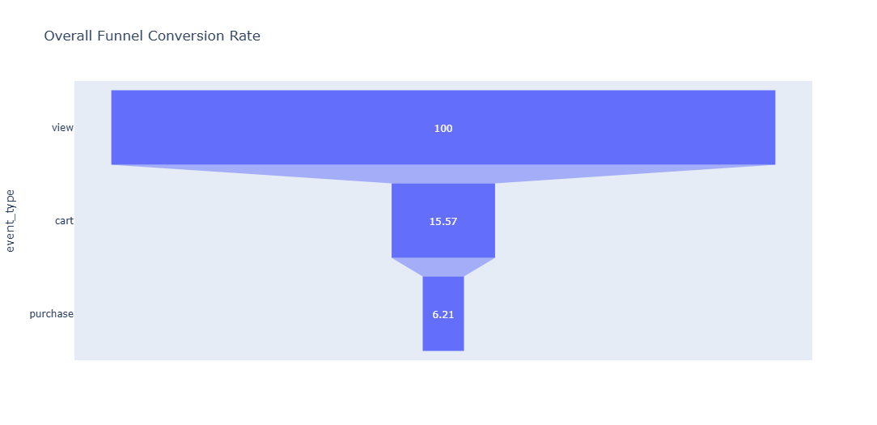
Funnel Analysis
Overall Funnel Drop
Major drop occurs from View → Cart (100% → 15.57%).
Only 6.21% of users complete a purchase.

Slide 8
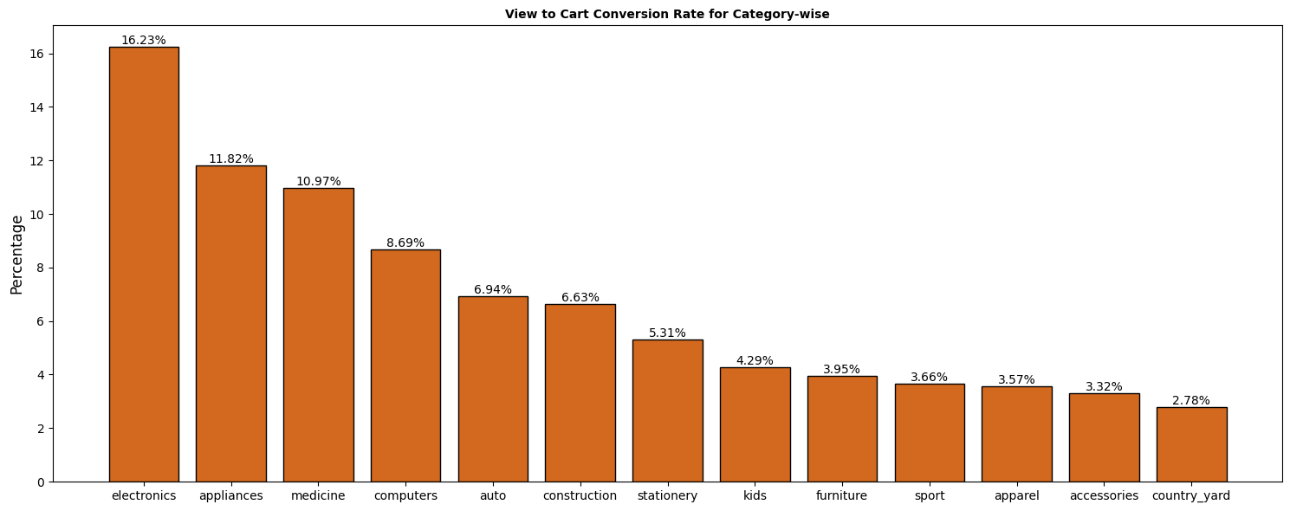
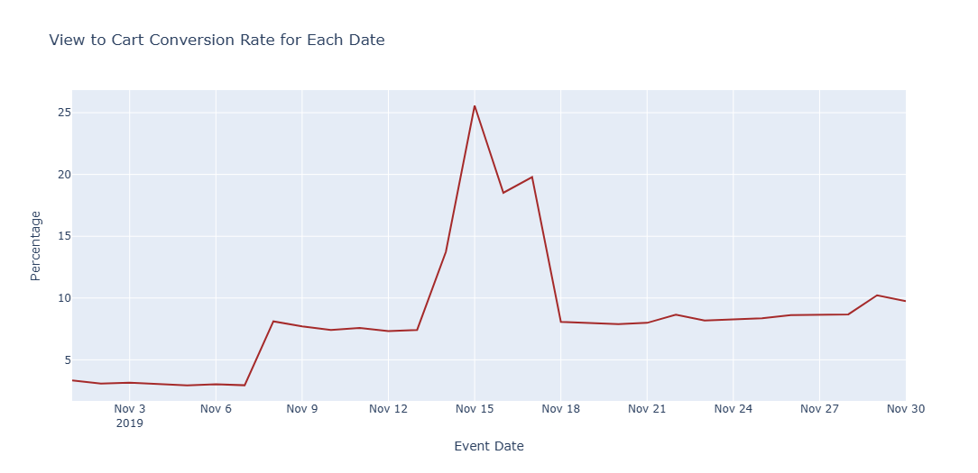
Category-wise View → Cart Conversion
Electronics, Appliances, and Medicine show the highest intent (10–16%).
Fashion categories (apparel, accessories) show low intent (3–4%).
Conversion strongly depends on category type and purchase urgency.
Date-wise Conversion Trend
Sharp spike around Nov 15–17, likely due to sales event or promotion.
Early November shows low conversion (3–4%).
Late November stabilizes around 8–10%, indicating steady user interest.

Slide 9
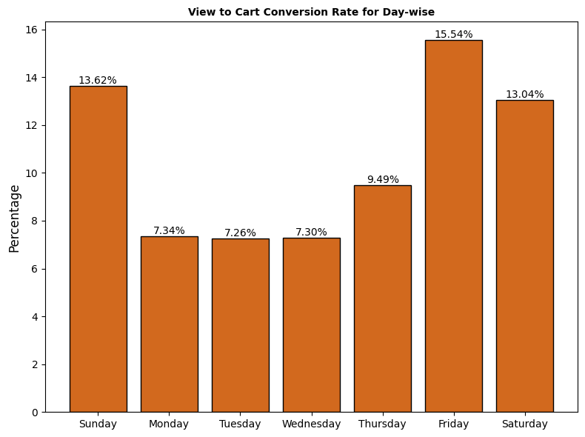
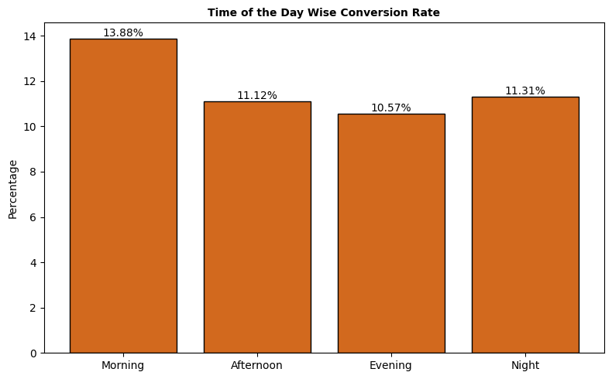
Day-wise Conversion
Friday, Sunday, Saturday show highest conversion (13–15%).
Mid-week days (Mon–Wed) show lowest conversion (~7%).
Users are more willing to add to cart on weekends and Fridays.
Time-of-Day Conversion
Morning has the highest intent (~14%).
Afternoon, Evening, and Night remain stable around 10–11%.
Users browsing in the morning show stronger purchase intent.

Slide 10
Insights :
  The biggest drop occurs from view to cart, with only 15.6% of users showing real purchase intent.
  Conversion varies by category, with electronics and appliances performing best and fashion performing the weakest.
  User intent peaks during mid-November promotions, weekends, and morning hours, indicating strong timing effects.
  Overall, only 6.2% of users reach purchase, highlighting clear opportunities to optimize product discovery and cart engagement.
Recommendations :
  Improve product detail visibility (ratings, delivery time, offers) to reduce the large view → cart drop.
  Add personalized nudges like “Recently viewed”, “Similar items”, or “Low-stock alerts”.
  Simplify the cart and checkout flow to reduce friction and improve final conversion.

Slide 11
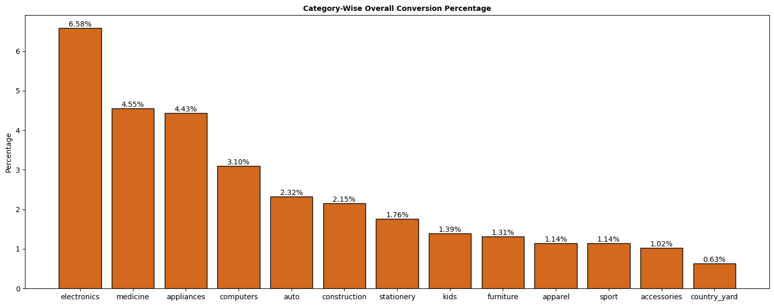
Category and Brand Performance
Category-Wise Conversion :
Electronics is the top-performing category (≈6.6%), showing strong buying intent for high-value products.
Medicine and Appliances also convert well (≈4.4–4.5%), driven by necessity-based purchases.
Categories like apparel, accessories, sport, furniture have very low conversion (<1.5%), indicating more browsing behavior than purchase intent.
Overall trend: Utility and tech categories convert better, while lifestyle categories lag.

Slide 12
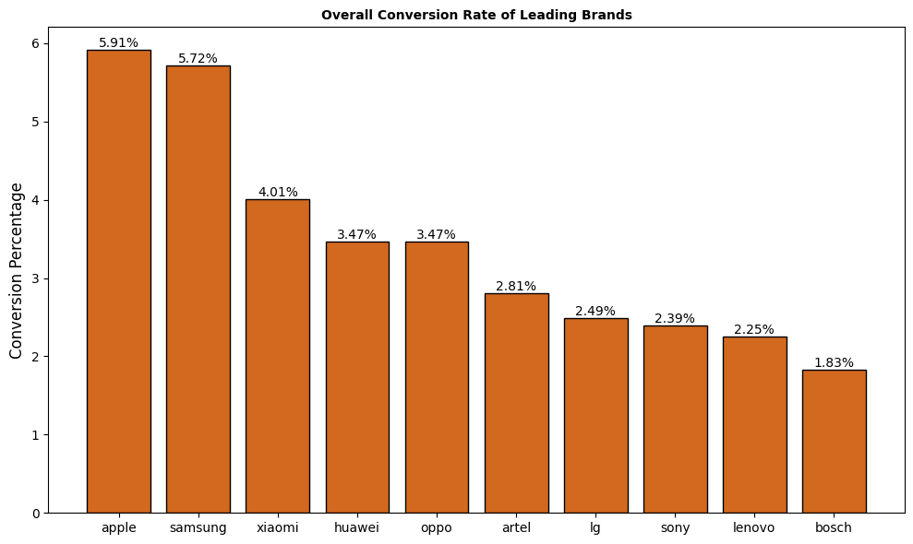
Brand-Wise Conversion
Apple and Samsung lead with the highest conversion rates (≈5.7–5.9%), showing strong brand trust and demand.
Xiaomi, Huawei, Oppo form the next strong cluster (3–4%), indicating mid-range buyers convert well too.
Bosch, Lenovo, Sony show lower conversion (<2.5%), possibly due to higher prices or more comparison behavior.
Conversion is highest among well-known, premium, and trusted brands.

Slide 13
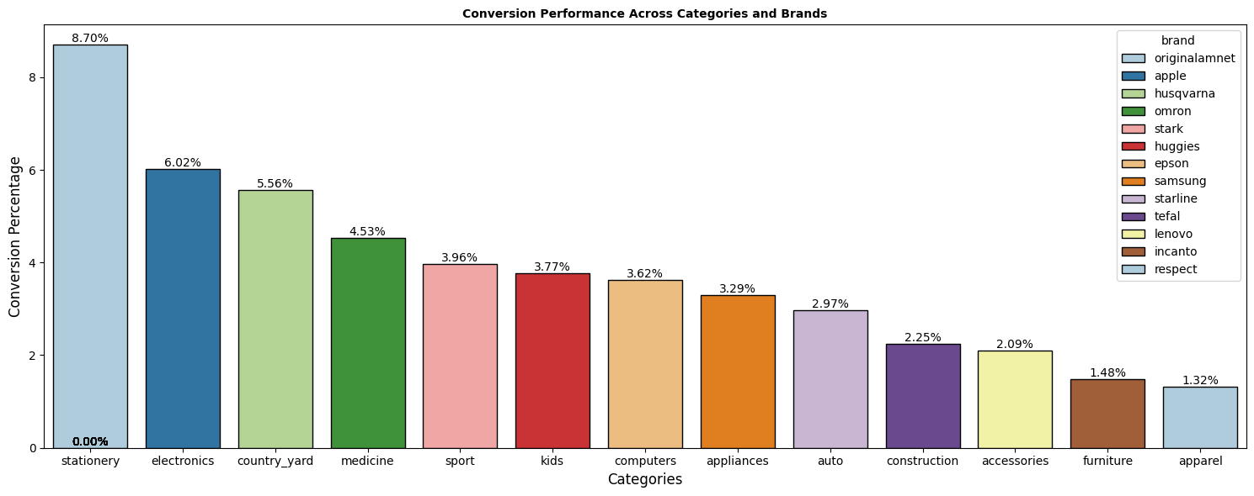
Category + Brand Combined :
In combined performance, stationery surprisingly shows strong conversion, likely due to low price and low decision effort.
Tech brands like Apple, Samsung, Epson continue to perform well across categories.
Categories like country_yard, apparel, accessories remain low, even with known brands—indicating weak intent.
Overall, brands with high trust + clear value proposition convert better across categories.

Slide 14
Insights
  High-intent categories such as electronics, medicine, and appliances show the strongest conversion, driven by necessity and trust.
  Premium and well-known brands like Apple and Samsung convert significantly better than mid-tier brands.
  Lifestyle categories such as apparel and accessories display low conversion, indicating heavy browsing but limited purchase action.
  Overall, conversion is highest in trusted brands and essential product categories, while discretionary categories lag behind.
Recommendations :
  Prioritize high-converting categories (electronics, appliances, medicine) in homepage placements and promotions.
  Improve product info and pricing strategies for low-performing categories like apparel and accessories.
  Strengthen partnerships and visibility for top-performing brands (Apple, Samsung, Xiaomi, LG, Huawei).

Slide 15
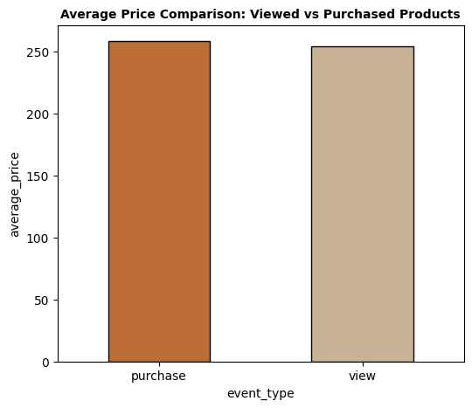
Price Sensitivity
Overall Price Comparison (View vs Purchase)
  The average purchase price is slightly higher than the average viewed price.
  Users tend to buy slightly more expensive products than what they browse.
  Indicates that customers compare options, but ultimately pick higher-quality or premium items.

Slide 16
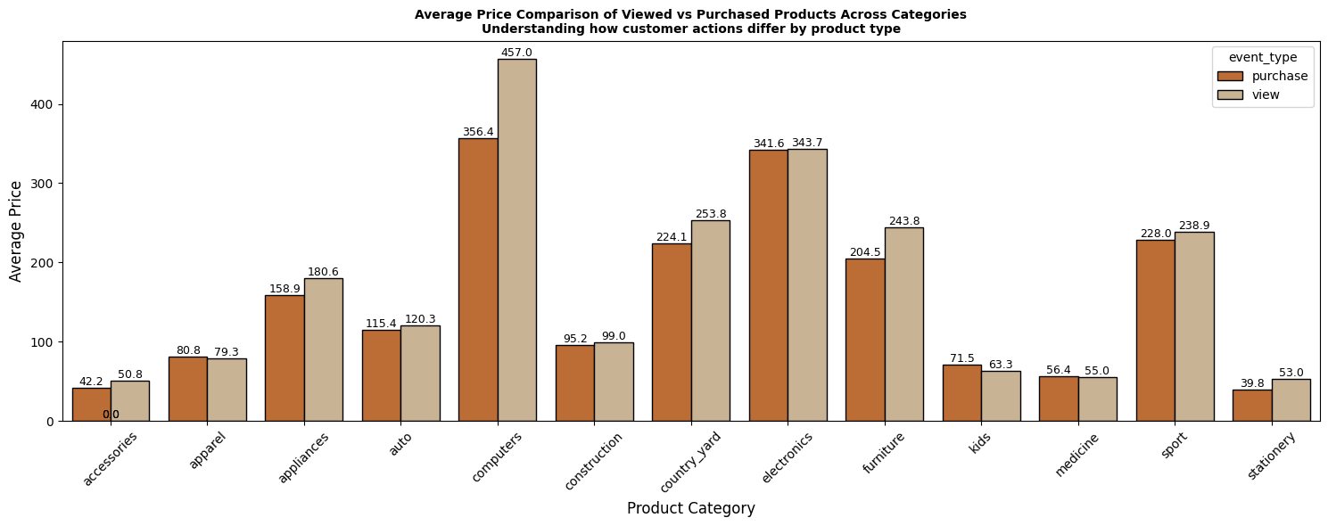
Category-Wise Price Sensitivity
  Categories like computers, electronics, country_yard, and furniture show higher viewed prices than purchased prices, meaning users browse expensive items but choose more affordable ones.
  In appliances and auto, the purchase price is lower but close to viewed price, suggesting moderate price sensitivity.
  Categories such as kids, medicine, and stationery show minimal price difference, meaning low price sensitivity due to necessity or low-ticket items.
  Users are most price-sensitive in high-ticket categories.

Slide 17
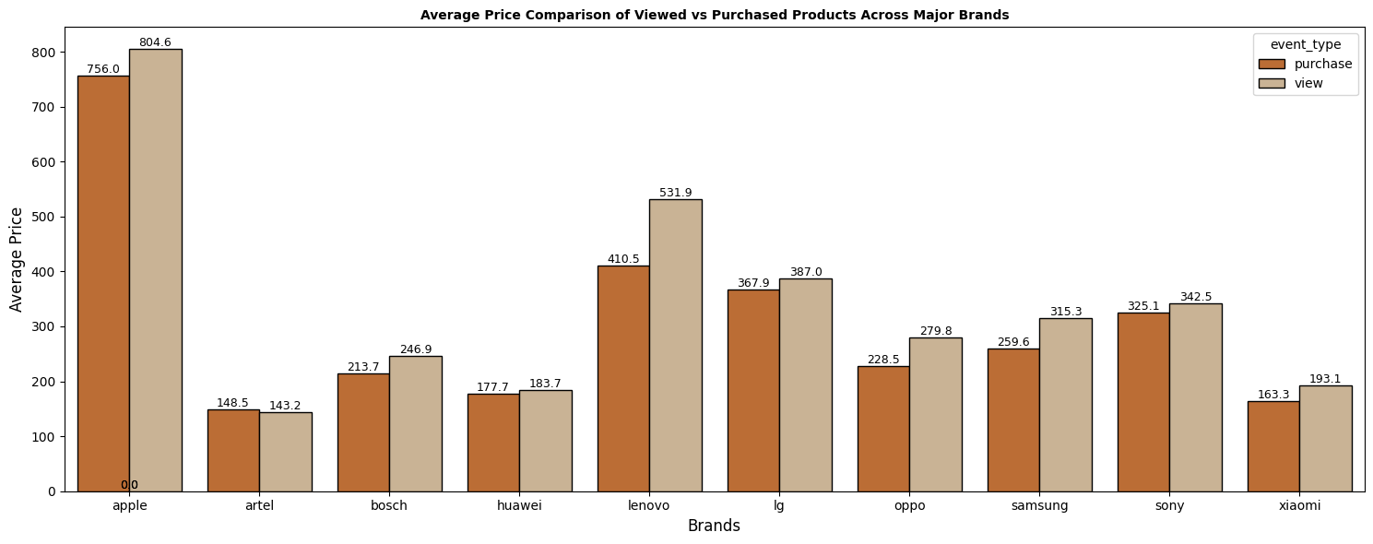
Brand-Wise Price Sensitivity
  Premium brands like Apple, Lenovo, Sony have higher viewed prices, but users purchase slightly lower-priced models — indicating value-conscious behavior even for premium brands.
  Mid-range brands like Samsung, Oppo, Xiaomi show small price differences, meaning customers are relatively consistent in both viewing and buying.
  Brands like Bosch and LG show a noticeable gap, meaning users browse expensive options but purchase cheaper variants.

Slide 18
Insights :
  Users tend to browse higher-priced items but purchase slightly cheaper alternatives, especially in expensive categories and brands.
  Price sensitivity is strongest in high-ticket categories like computers and electronics.
  Low-ticket and necessity categories show consistent viewing and buying prices, indicating low sensitivity.
Recommendations :
  Offer mid-range alternatives for high-ticket categories where users drop from expensive viewed → cheaper purchased products.
  Highlight EMI options, warranties, and exchange offers to reduce price hesitation.
  Use personalized discounts for price-sensitive user segments.

Slide 19
User Behavior & Top User Contribution
Power User Contribution
  The top 10% of active users (≈236k users) contribute 43.8% of total purchase value.
  This indicates a high concentration of revenue among a relatively small group of loyal users.
Behavior of Power Users
  Power users are significantly more engaged, completing more views, carts, and purchases than the average user.
  They show higher purchase frequency and stronger intent, which leads to a larger share of revenue.

Slide 20
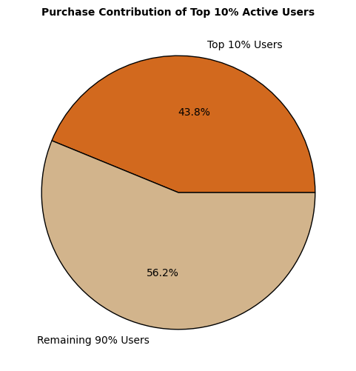
Retention:
  The top user segment is likely better retained, returning more often and consistently contributing to the platform’s revenue.
  The remaining 90% of users contribute 56.2%, but their individual purchase activity is much lower.

Slide 21
Insights :
  The top 10% users are high-value customers, generating nearly half of total revenue.
  They show stronger retention and engagement, making them critical for business growth.
  Targeted loyalty or rewards programs could further strengthen this segment.
Recommendations :
  Launch loyalty benefits for top 10% power users (early access, exclusive deals, reward points).
  Create personalized product recommendations based on past purchases.
  Use targeted remarketing campaigns to retain high-value users.

Slide 22
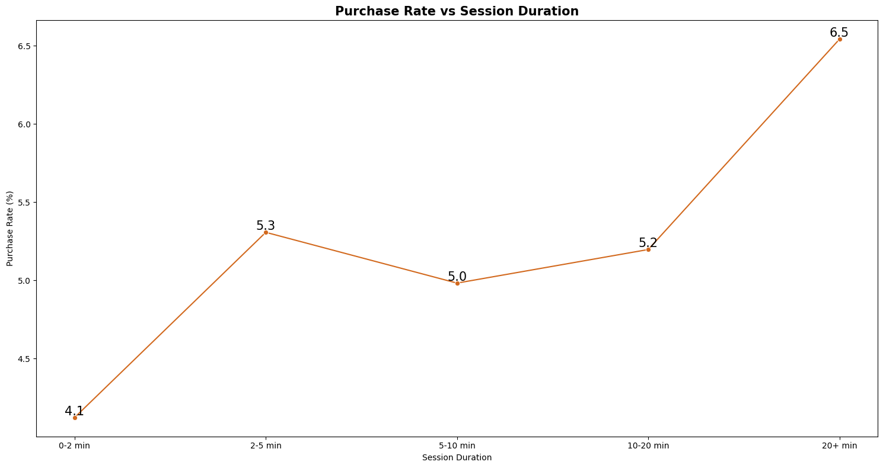
Session Behaviour
Purchase Likelihood Increases With Longer Sessions
  Users with 0–2 min sessions have the lowest purchase rate (4.1%).
  Purchase likelihood rises steadily for longer sessions, peaking at 6.5% for 20+ min users.
  Longer engagement indicates higher intent and deeper product exploration.
Mid-Range Sessions Show Stable Intent
  The 2–5 min (5.3%) and 5–10 min (5.0%) ranges show moderate and consistent intent.
  These users explore products enough to consider purchase but not deeply enough for strong commitment.
High-Intent Users Spend More Time Browsing
  Users in the 10–20 min (5.2%) and 20+ min ranges have the highest likelihood to buy.
  These users are likely comparing prices, checking product details, and reviewing alternatives before purchasing.

Slide 23
Insights
  More time spent → higher purchase probability.
  Quick sessions convert poorly, while long, engaged sessions show strong buying intent.
  Focusing on keeping users engaged longer may increase conversions.
Recommendations :
  Increase session duration by improving product discovery (better filters, personalized lists, search suggestions).
  Offer “quick comparison” tools to help long-session users convert faster.
  Trigger reminders or offers for users with longer browsing behavior but no purchase.

Slide 24
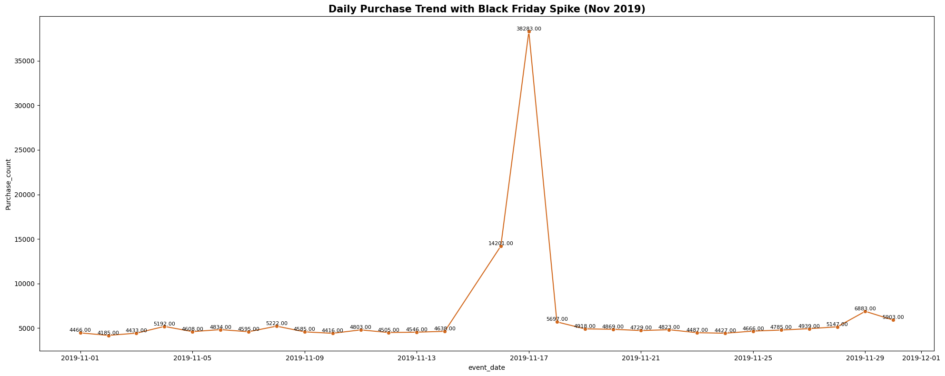
Time-Based Trends (Day & Hour Analysis)
Daily Purchase Trends
  Purchases stay fairly stable throughout early November, averaging 4,000–5,000 per day.
  A massive spike occurs on November 17 (14,201 purchases) and Black Friday (38,283 purchases) due to heavy promotions.
  Purchases rise again toward the end of the month, especially around Nov 29 (6,883 purchases)—likely another sale weekend.

Slide 25
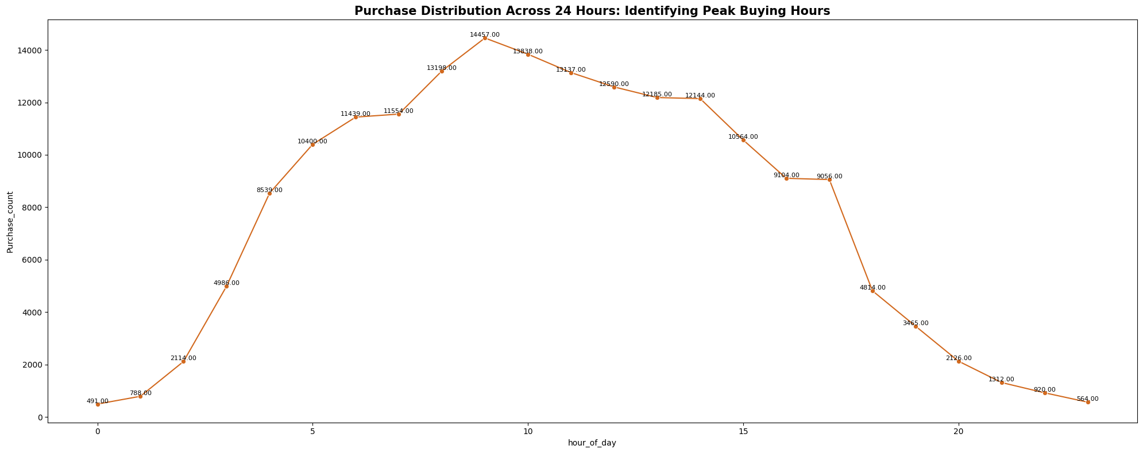
Hourly Purchase Trends (24-Hour Cycle)
  Purchases climb sharply from 4 AM onward, peaking between 9 AM – 11 AM (13,000–14,500 purchases).
  Afternoon hours (12 PM – 4 PM) remain strong with 12,000–13,000 purchases.
  Activity declines steadily after 5 PM, dropping significantly after 8 PM.
  Lowest activity occurs between 12 AM – 3 AM.

Slide 26
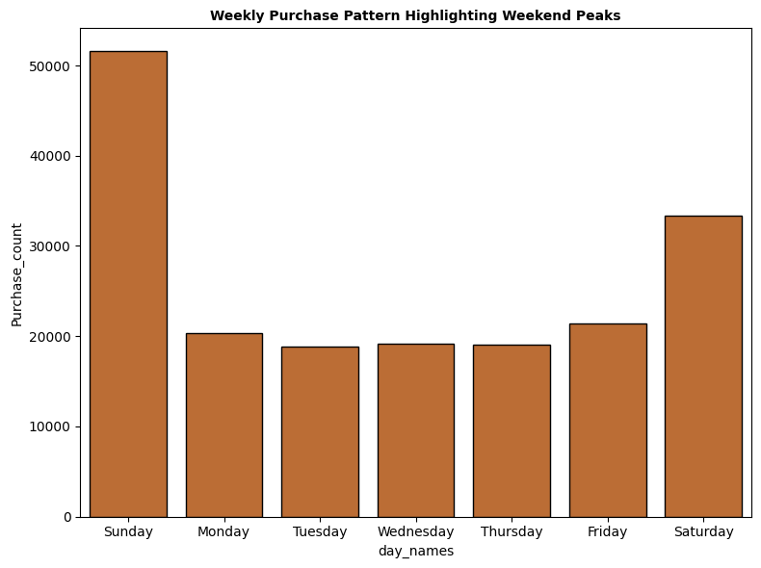
Weekly Purchase Patterns
  Sunday shows the highest weekly purchase activity, exceeding 52,000 purchases.
  Saturday is the next strongest purchasing day (~33,000 purchases).
  Weekdays (Mon–Thu) have significantly lower purchase counts (~18,000–20,000), indicating reduced shopping during workdays.
  Friday shows a mild increase (~21,000), suggesting early weekend shopping behavior.

Slide 27
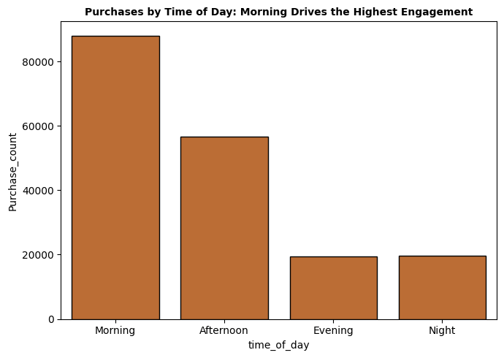
Time-of-Day Pattern (4-segment view)
  Morning is the strongest sales window (~88,000 purchases).
  Afternoon follows with moderate activity (~57,000 purchases).
  Evening and Night are lowest (~19,000 purchases each), reflecting reduced late-day intent.

Slide 28
Insights :
  Purchases peak during mornings and on weekends, especially Sunday.
  Major spikes occur during promotional events like Black Friday.
  Lowest purchasing happens on weekdays and during late-night hours.
Recommendations :
  Run major campaigns and discounts on weekends and morning hours where purchase intent peaks.
  Schedule notifications, emails, and ads during peak windows (9 AM–12 PM).
  Reduce spend during low-performing late-night hours to optimize marketing cost.

Slide 29
High-Value Products (Pareto Analysis)
Apple alone drives 50%+ of revenue, making a 20% threshold invalid.
Switching to the 80/20 Pareto method reveals that Apple, Samsung, Xiaomi, LG, and Huawei generate nearly 80% of total revenue.
Revenue is highly concentrated, dominated by a small group of top-performing brands.

Slide 30
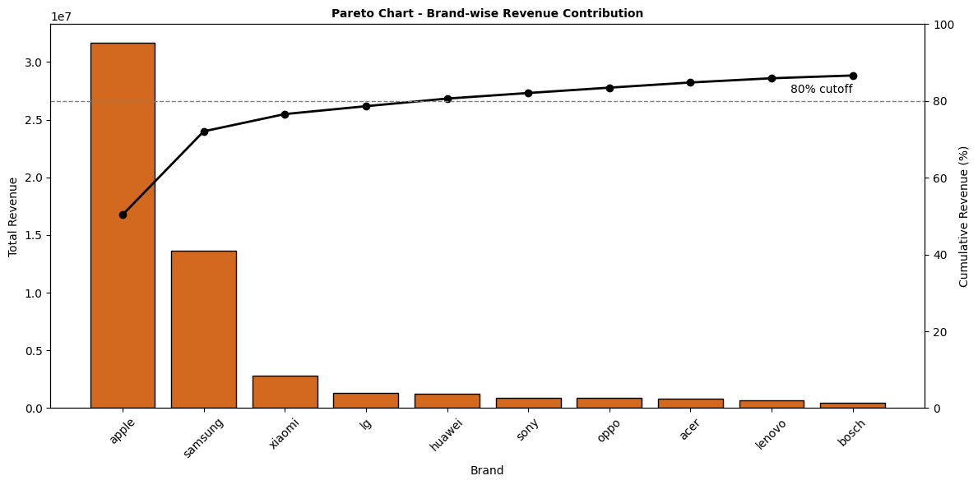
Apple dominates revenue (>50%), making the 20% cutoff unusable.
Using the Pareto 80% rule, Apple, Samsung, Xiaomi, LG, and Huawei emerge as high-value brands.
Revenue is heavily concentrated among a few top players.
Recommendations :
  Prioritize inventory, visibility, and promotional placement for core revenue brands: Apple, Samsung, Xiaomi, LG, Huawei.
  Optimize pricing and bundling strategies for top revenue-generating products.
  Use these high-value brands to attract traffic through deal banners and featured sections.

